Slide 1
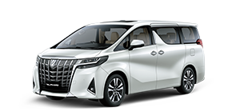
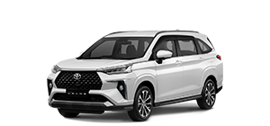
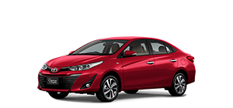
Katalog Mobil
Coded by : Kelompok 2

Slide 2

Pembagian Tugas
Kelvin Chandra
[MySQL] Database
[XML] Login & Register UI
Konten dalam Aplikasi
PPT
Ferry Gunawan
[Java] Login & Register
[PHP] Webservices
[XML & Java] User List
[XML & Java] User Update
Reynaldo Krisno
[XML] Mobil Description
[XML & Java] Home UI
[XML & Java] Toolbar
PPT & Moderator
Felix Setiawan
[Java] Mobil Description
[XML & Java] Gridlist Mobil
[XML & Java] Bottom Navigation
PPT
RK

Slide 3







Teknologi yang digunakan :
Android Studio
MySQL
GitHub Desktop
PHP
Visual Studio Code
JAVA
XAMPP
XML
RK

Slide 4

Requirement yang dibutuhkan :
*Untuk menjalankan aplikasi Katalog Mobil
Android API 27 [OREO]
XAMPP
RK

Slide 5
Fitur Aplikasi
Login dan Register User
Katalog Mobil lengkap dengan Gambar dan Nama Mobil
Deskripsi mobil lengkap dengan Harga dan Deskripsi
Melihat daftar User
Mengedit & menghapus User
RK

Slide 6
Run "Katalog Mobil"
Launching...
RK

Slide 7
DATABASE
Coded by : Kelvin Chandra
KC

Slide 8
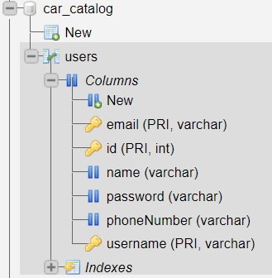
Database car_catalog
KC

Slide 9
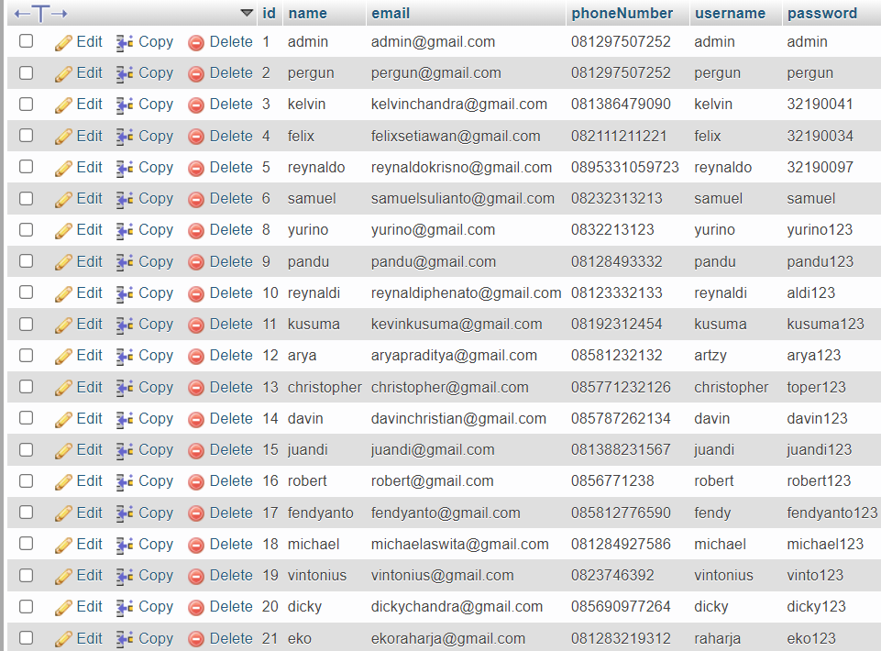
Isi table users
KC

Slide 10
PHP
Coded by : Ferry Gunawan
FG

Slide 11
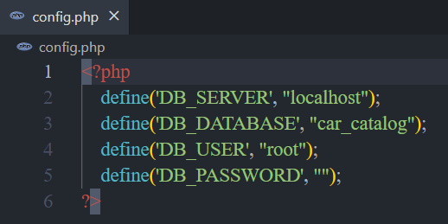
config.php
FG

Slide 12
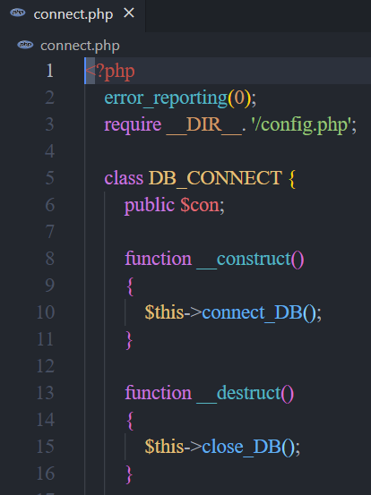
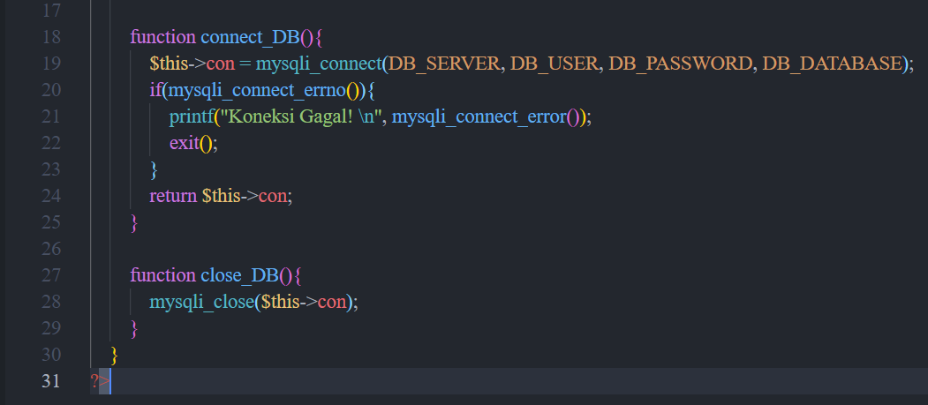
connect.php
FG

Slide 13
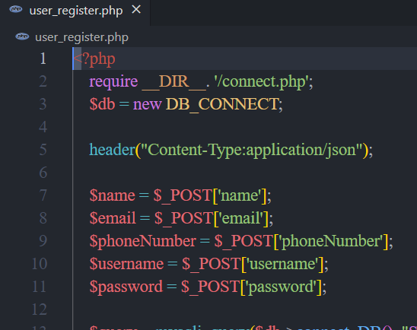
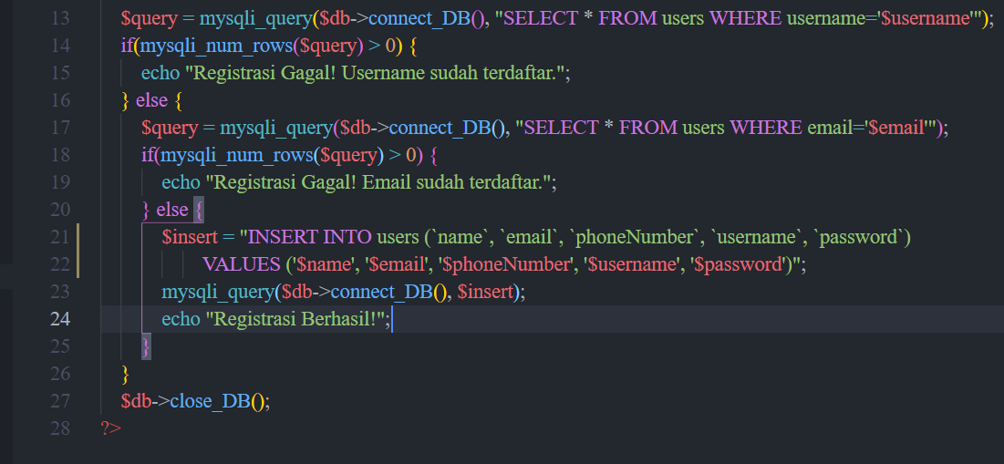
user_register.php
FG

Slide 14
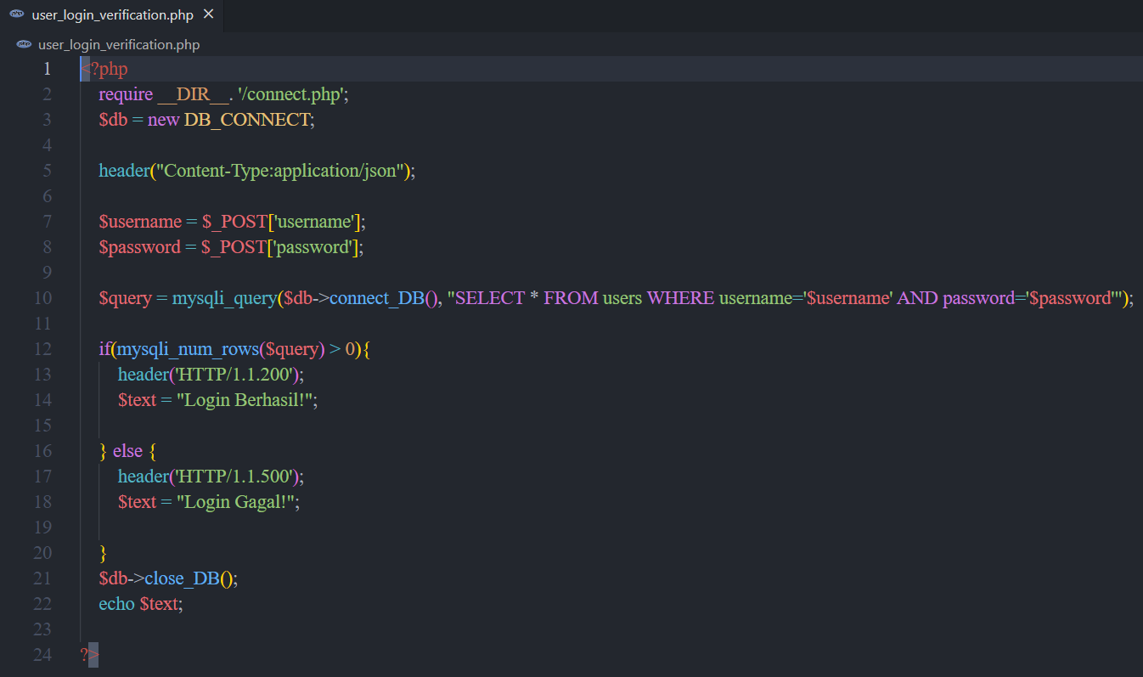
user_login_verification.php
FG

Slide 15
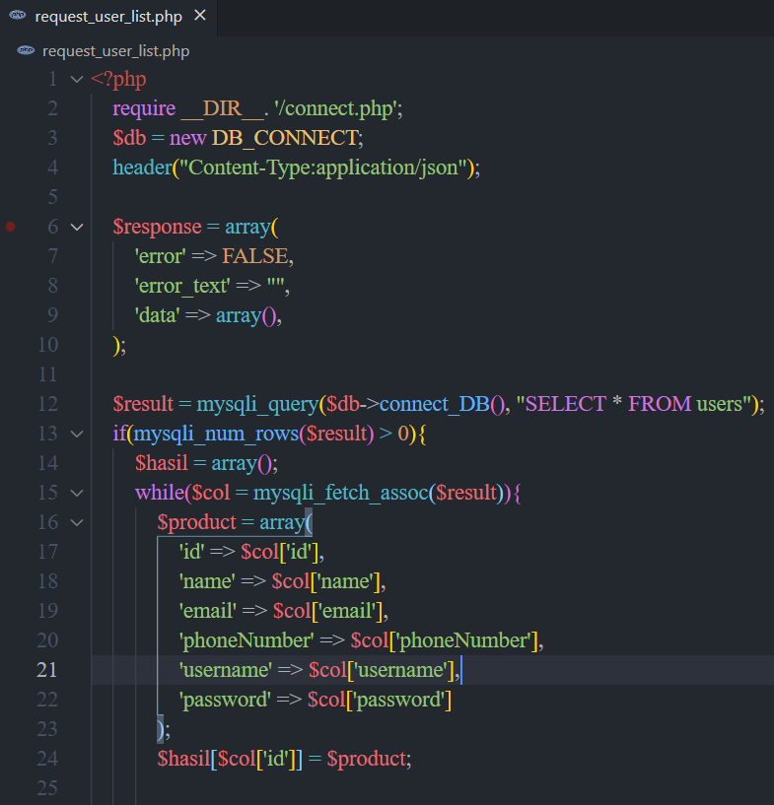
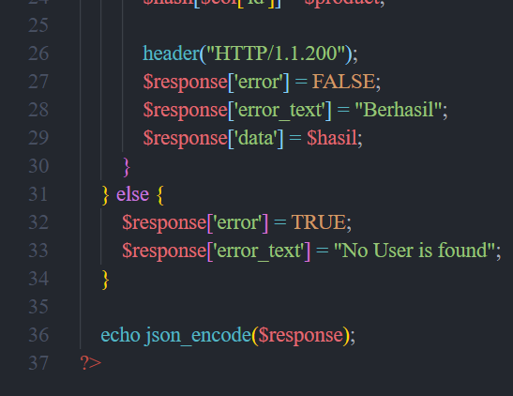
request_user_list.php
FG

Slide 16
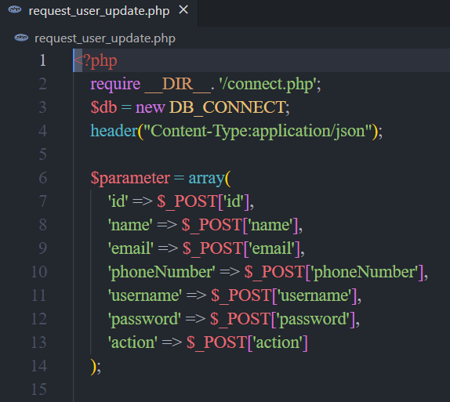
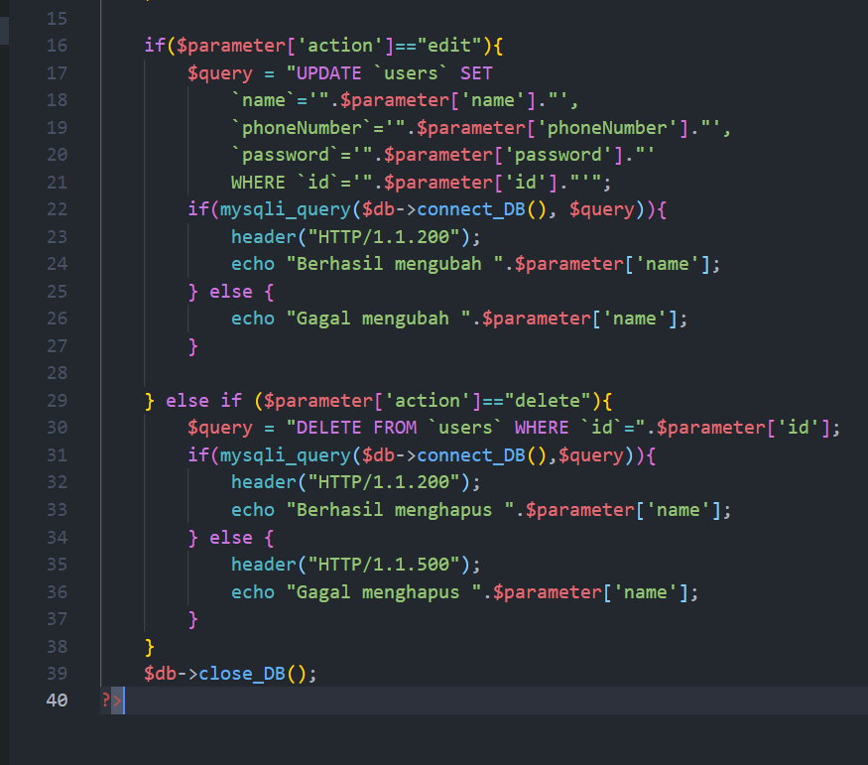
request_user_update.php
FG

Slide 17
LAYOUT XML
Coded by : Everyone

Slide 18
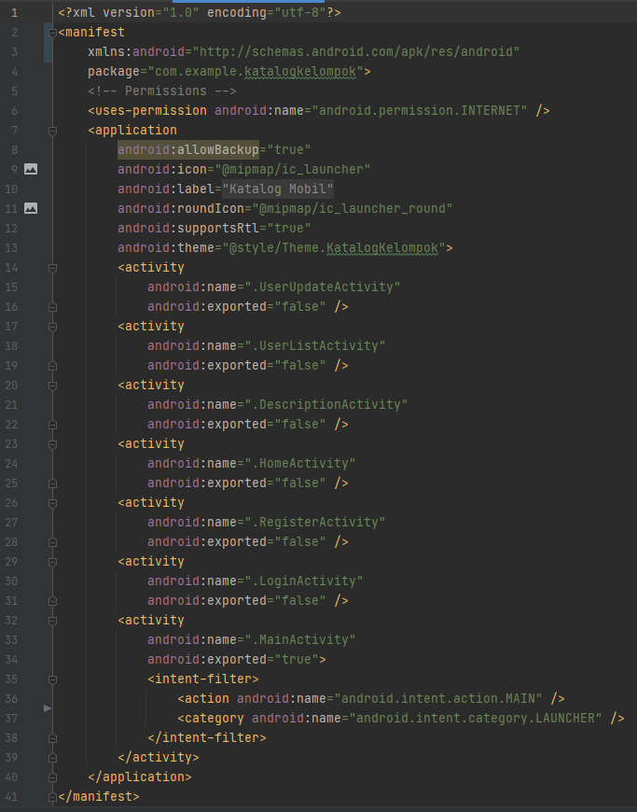
AndroidManifest.xml
KC

Slide 19

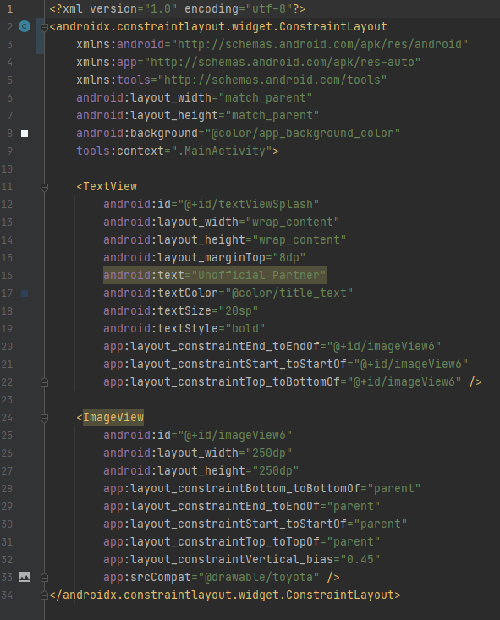
activity_main.xml
KC

Slide 20
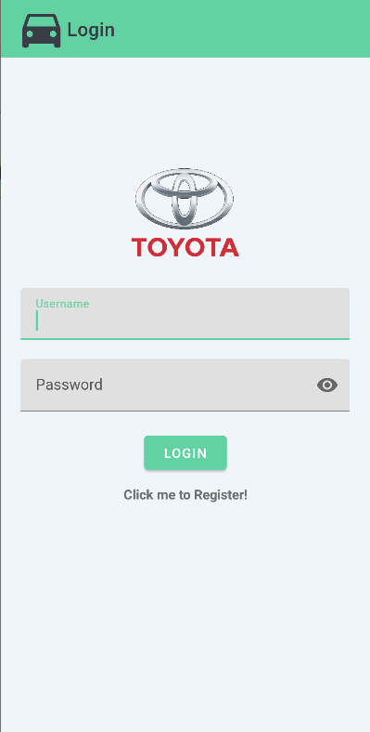
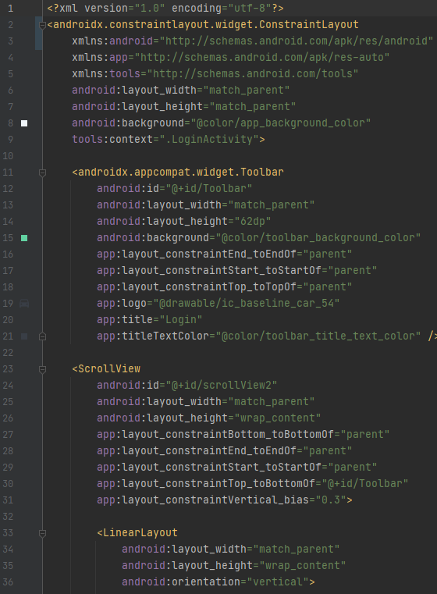
activity_login.xml
KC

Slide 21
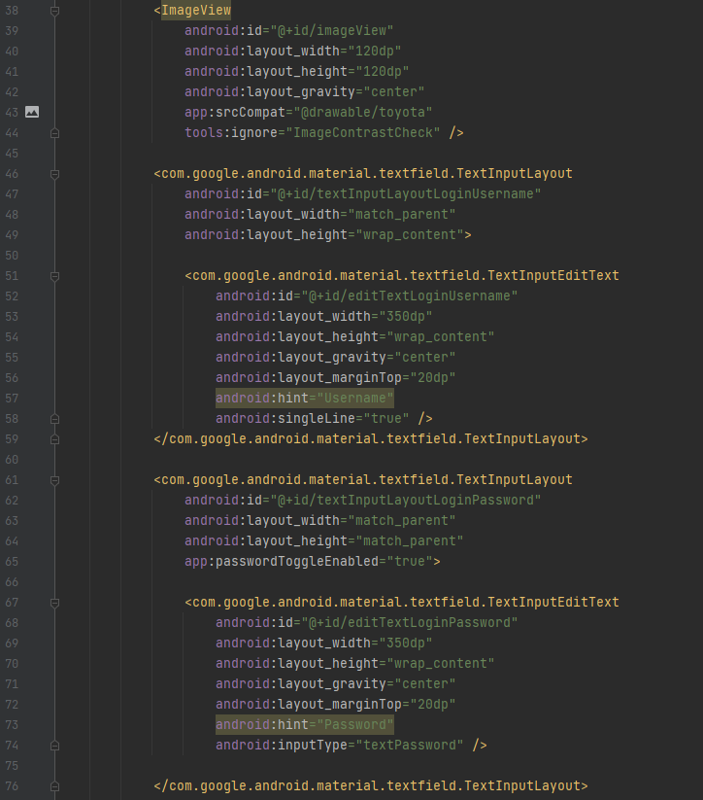
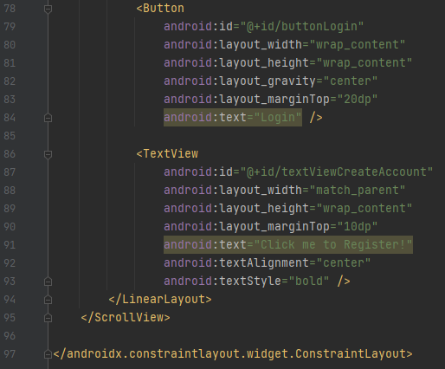
activity_login.xml
KC

Slide 22
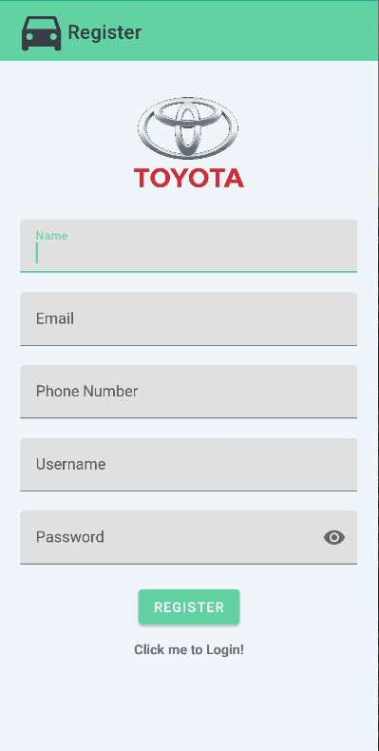
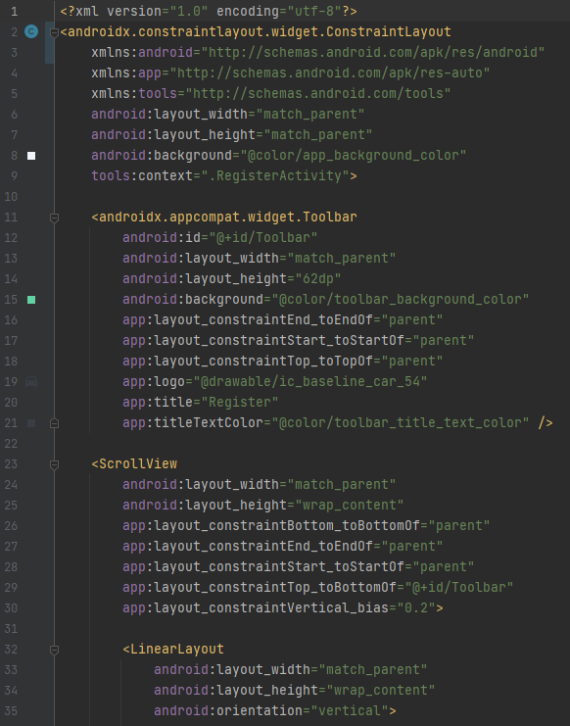
activity_register.xml
KC

Slide 23
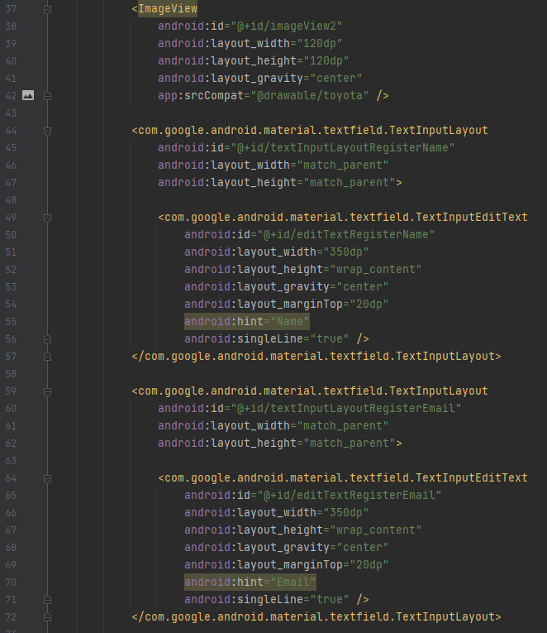
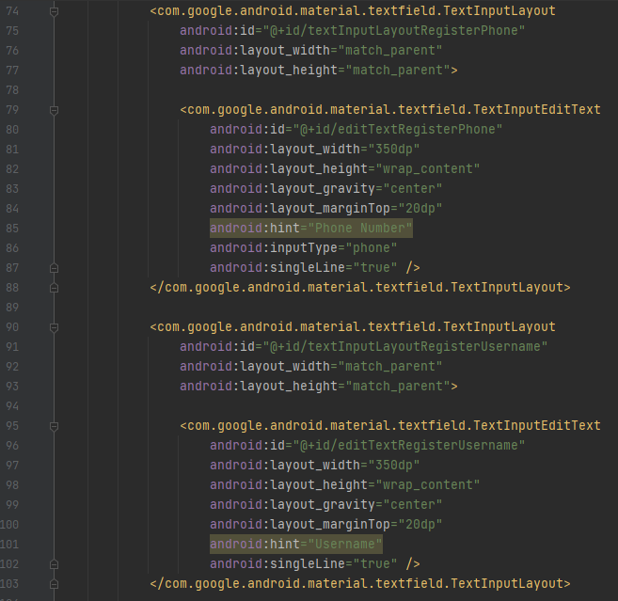
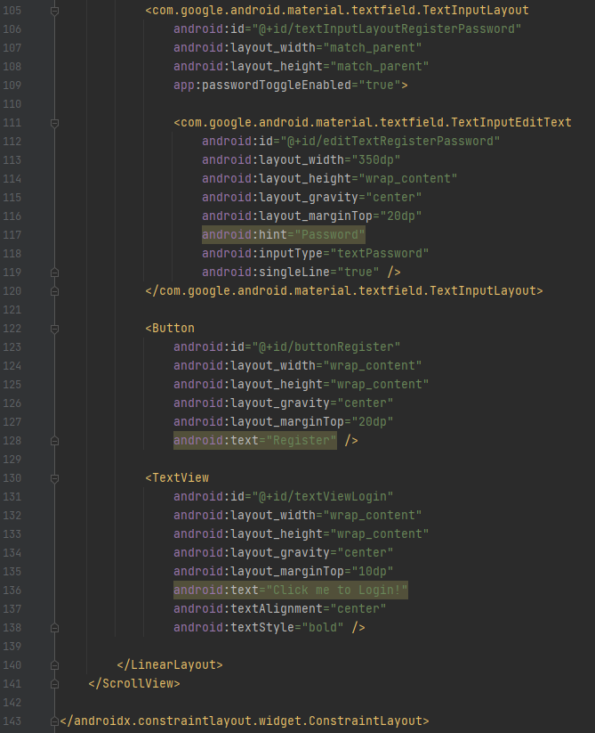
activity_register.xml
KC

Slide 24
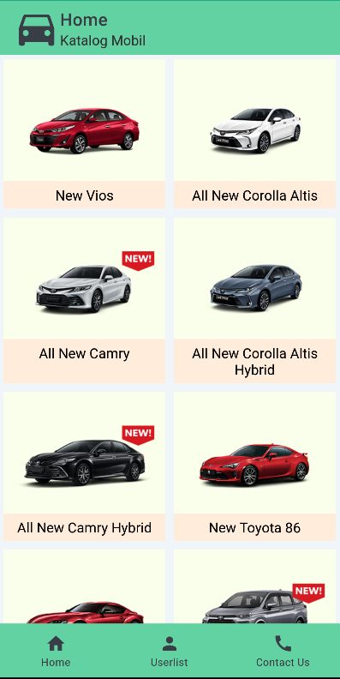
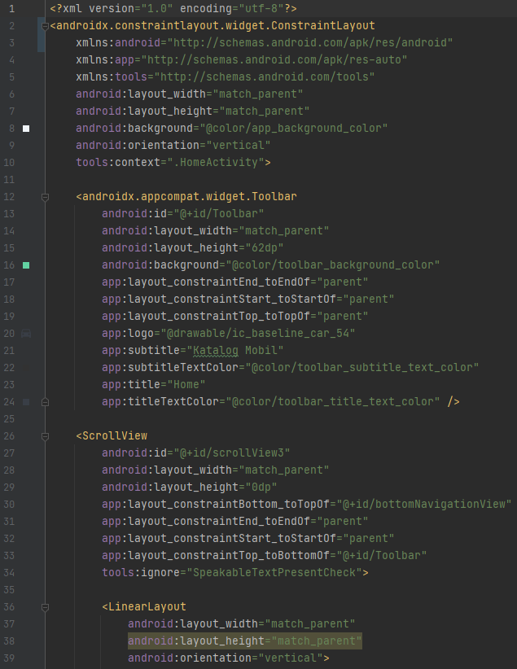
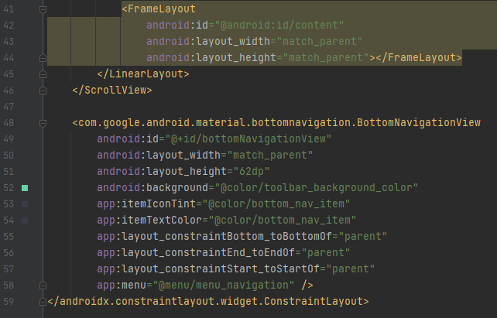
activity_home.xml
RK

Slide 25
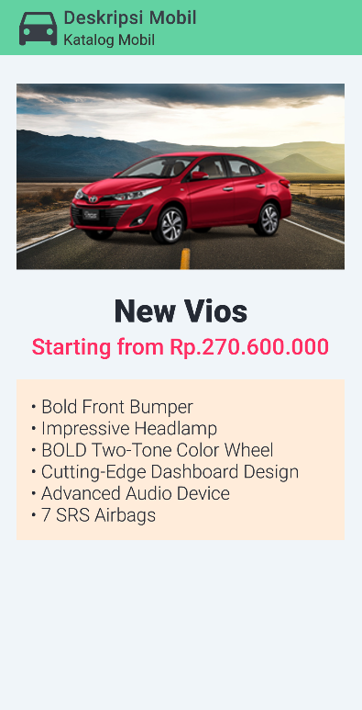
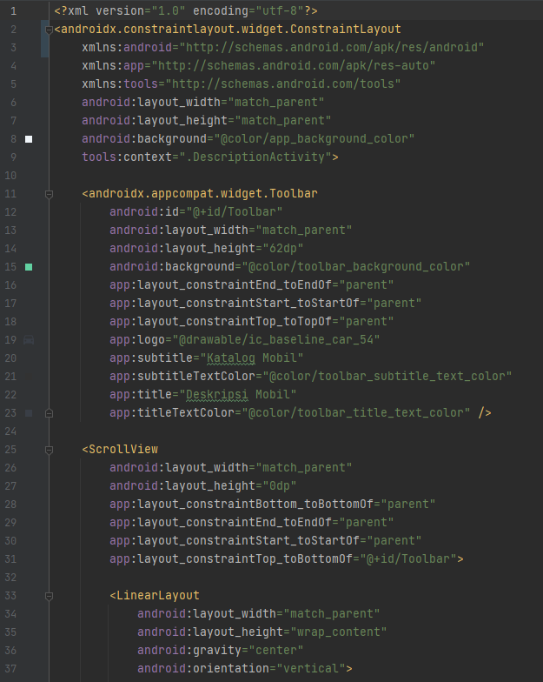
activity_deskripsi.xml
FS

Slide 26
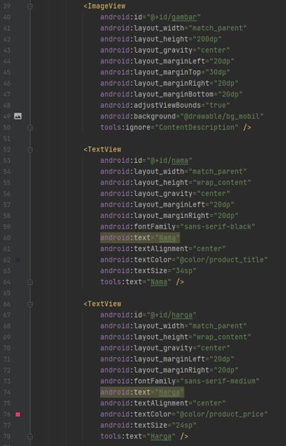
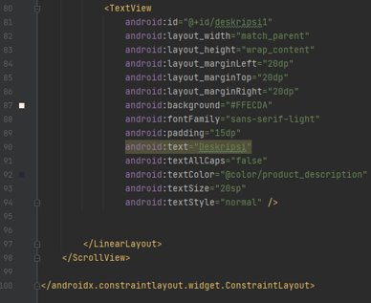
activity_deskripsi.xml
FS

Slide 27
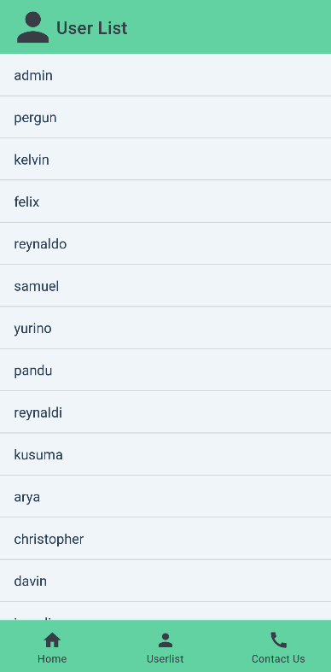
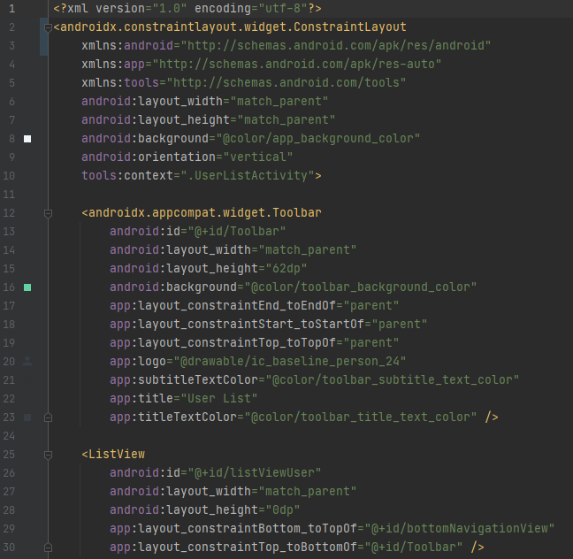
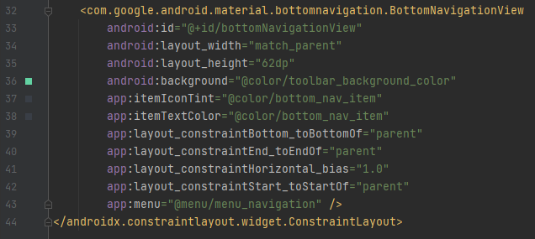
activity_user_list.xml
FG

Slide 28
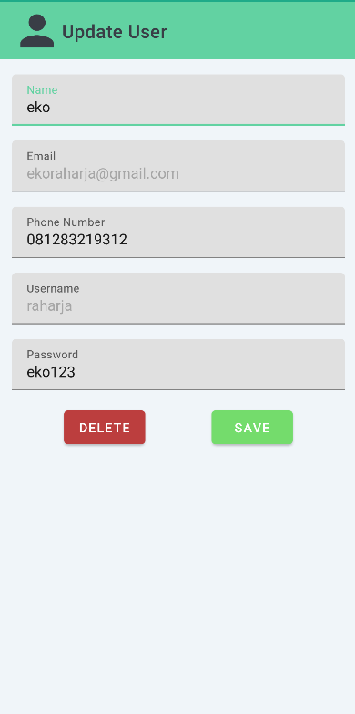
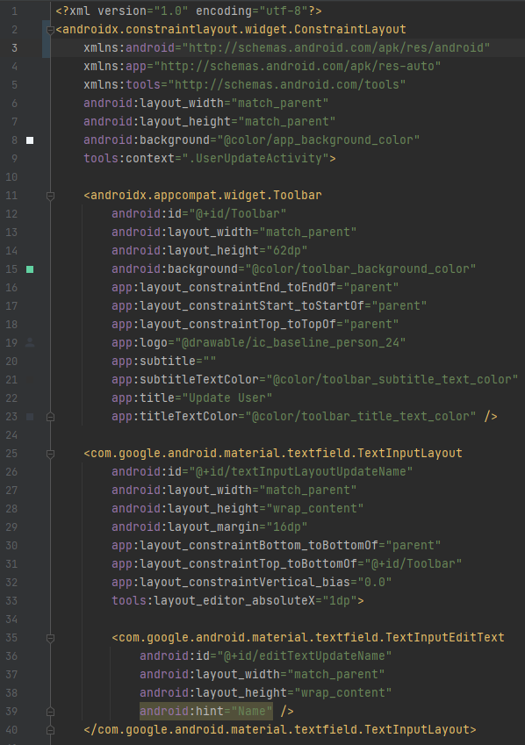
activity_user_update.xml
FG

Slide 29
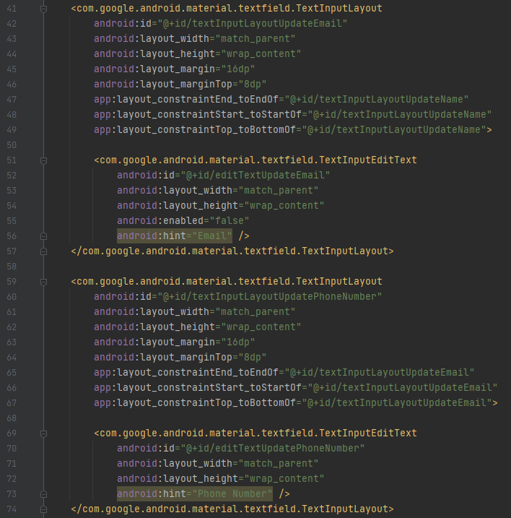
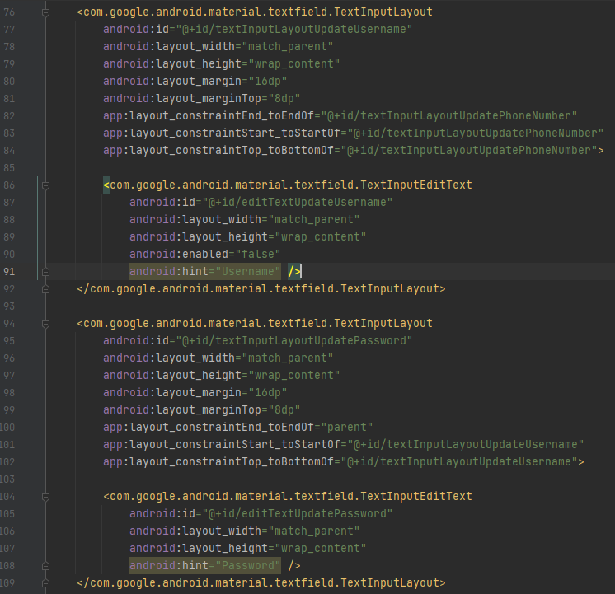
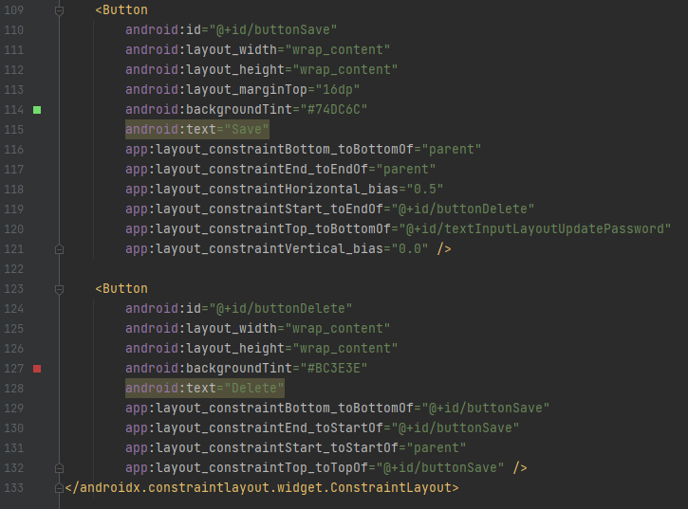
activity_user_update.xml
FG

Slide 30
JAVA
Coded by : Everyone

Slide 31
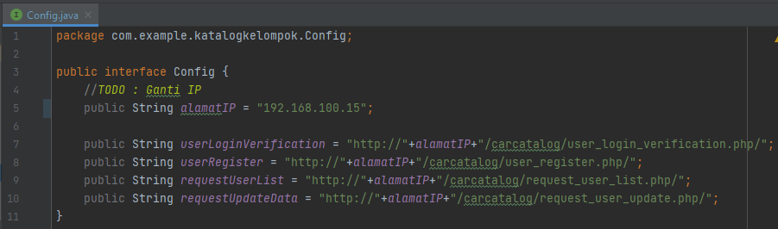
Config.java
KC

Slide 32
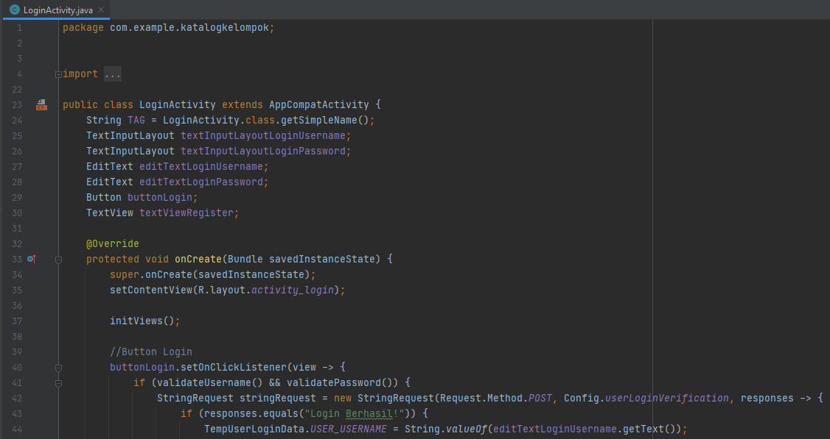
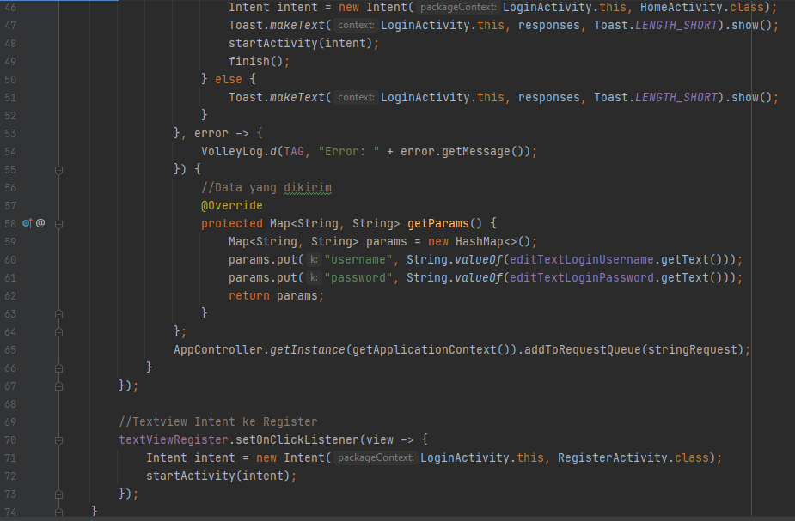
LoginActivity.java
KC

Slide 33
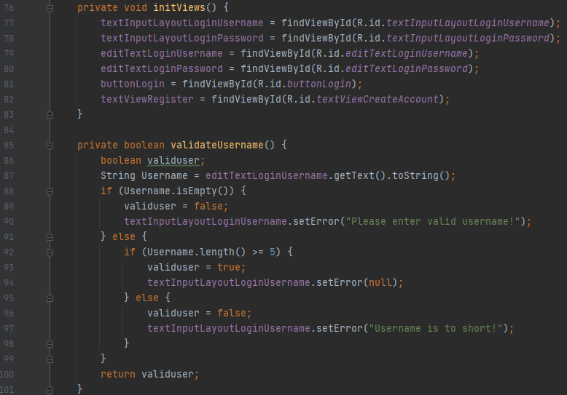
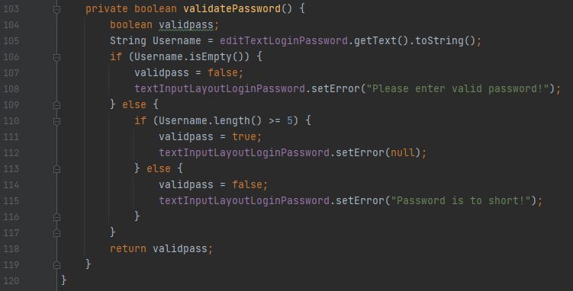
LoginActivity.java
KC

Slide 34
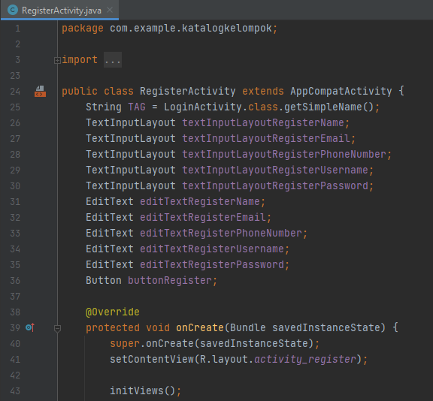
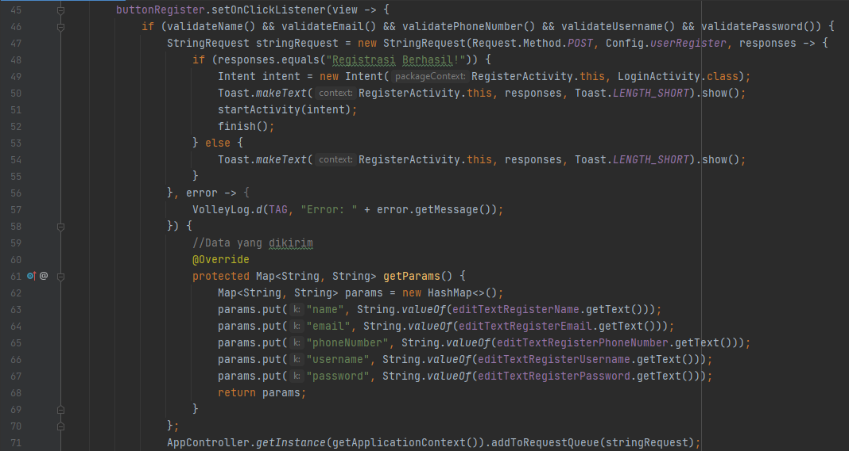
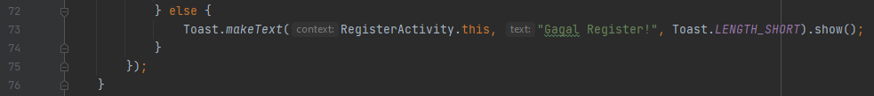
RegisterActivity.java
KC

Slide 35
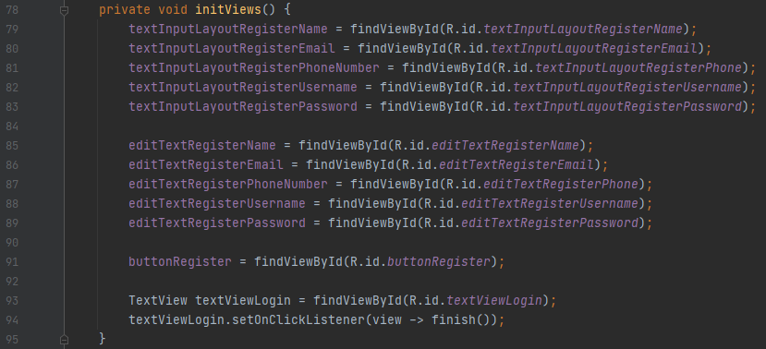

RegisterActivity.java
KC

Slide 36


RegisterActivity.java
KC

Slide 37


RegisterActivity.java
KC

Slide 38


HomeActivity.java
RK

Slide 39


FragmentMobil.java
FS

Slide 40

FragmentMobil.java
FS

Slide 41

DescriptionActivity.java
FS

Slide 42


UserListActivity.java
FG

Slide 43

UserListActivity.java
FG

Slide 44


UserListActivity.java
FG

Slide 45


UserUpdateActivity.java
FG

Slide 46


UserUpdateActivity.java
FG

Slide 47

UserUpdateActivity.java
FG

Slide 48


Sekian dan Terima kasih

